Slide 1

English Premier League Pool
Domingo Loria
Jaime Rueda
Marie Dagan
Ricardo Paulin

Slide 2
What is it?
A gambling game

Slide 3

And for EPL followers…
Demonstrate your knowledge of the game and the league
Track your progress throughout the season
Discover trends and look for hints using the information tool
Be the king of the rankings!!!

Slide 4
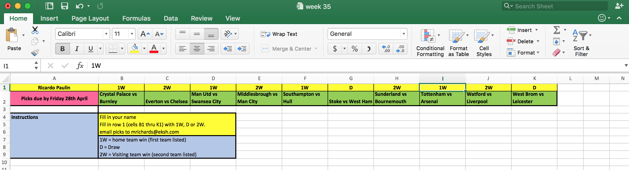
How it’s been done for years

Slide 5
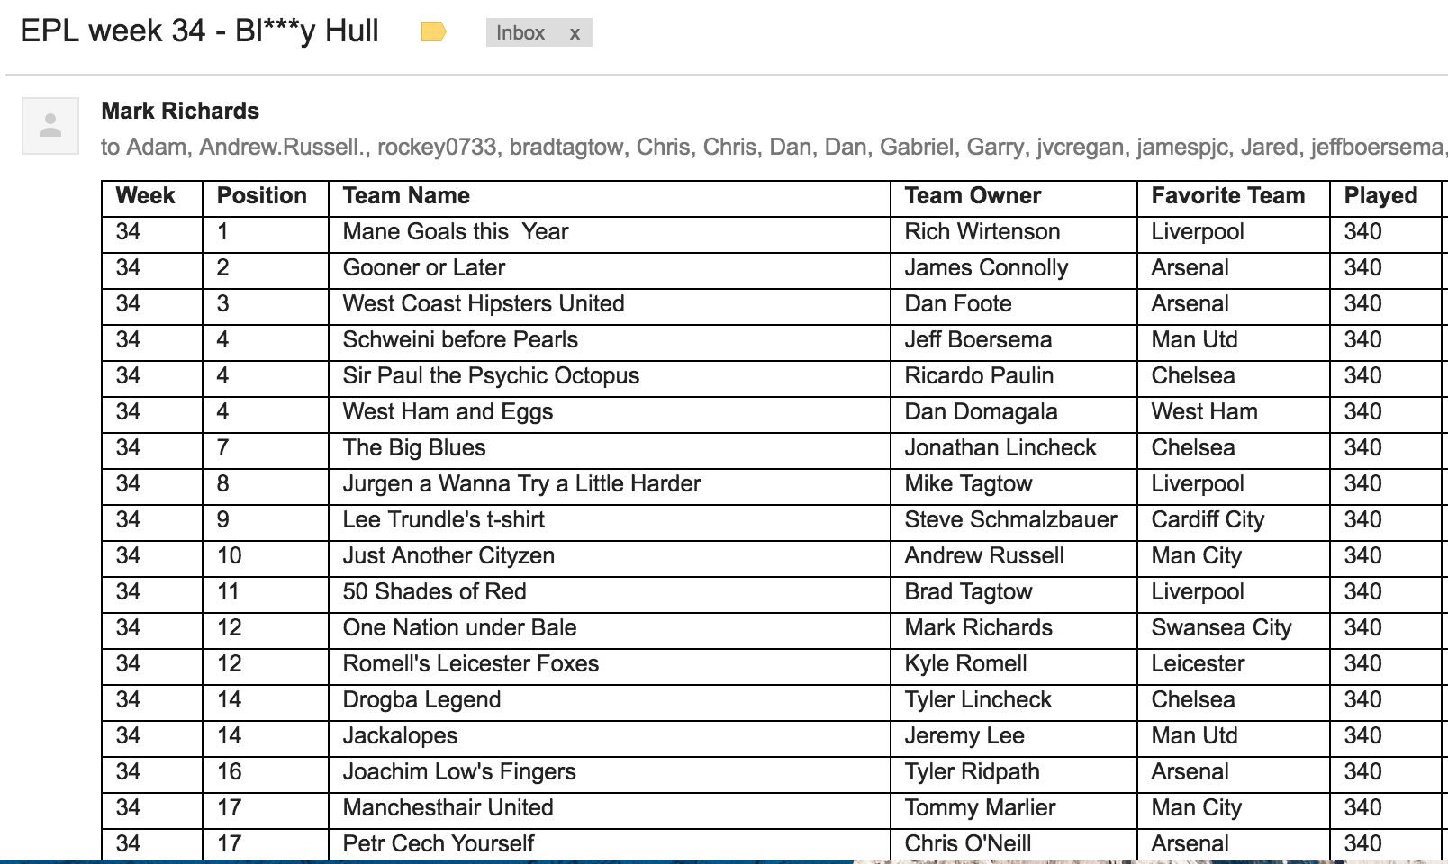

Slide 6
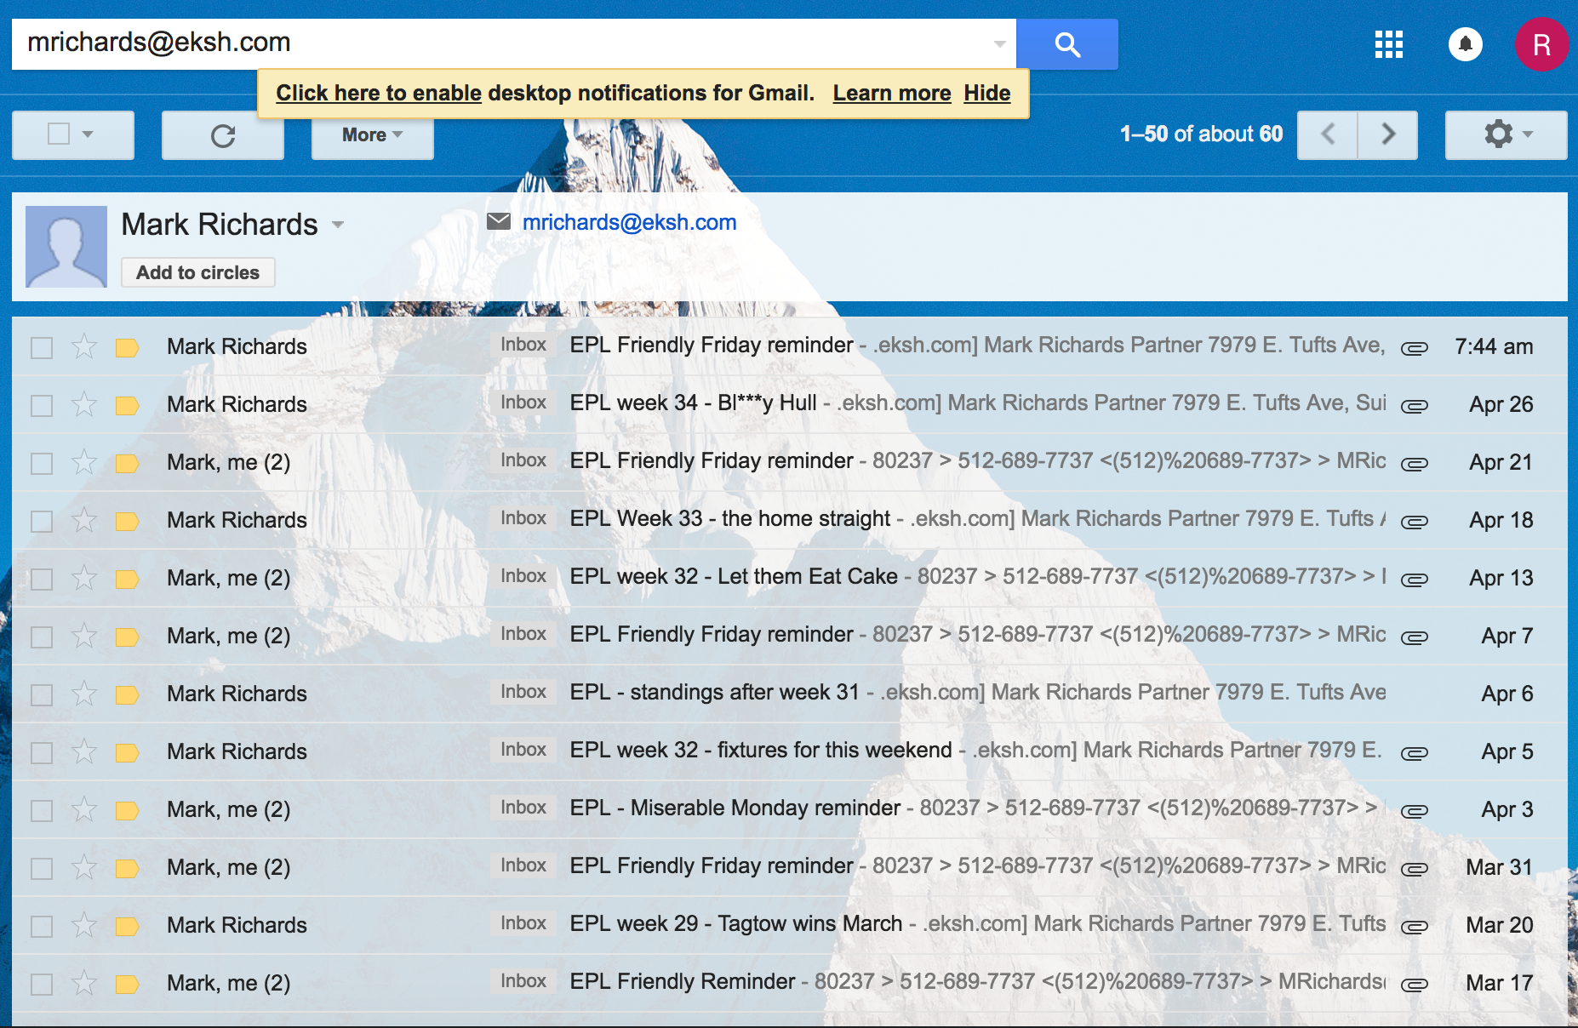

Slide 7
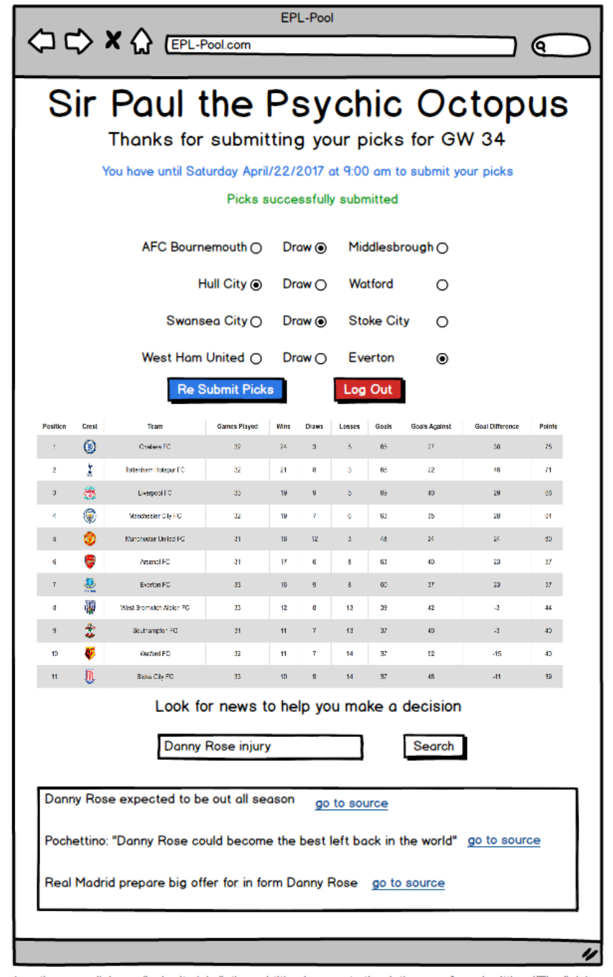
The vision

Slide 8
What does this require then?
Each user needs to be able to submit their own picks and not someone else’s
The app must
remember each user’s picks
determine what gameweek it is and what games are scheduled to be played
Know what was the result of each game
Be able to tell if a user got a pick right or wrong
Assign the corresponding points and remember them
Add the total points and create a ranking of all users
Know how many guesses each user has submitted
Be able to obtain relevant information specific to each team in the Premier League
Be user friendly
Look professional and appealing to potential players

Slide 9
How do we even do that?

Slide 10
Divide project into clear chunks
Database storage and user authentication
Firebase authentication and database
1st API communication and callback functions (obtain correct information for picks section)
Moment JS
Football-data.org API
2nd API communication and callback functions (to build info tool)
Jokecamp API
Guardian API
Semantic UI
Styling and user interaction (modals,graphs,tables,sign in,etc)
Semantic UI
Izimodal
Chart JS

Slide 11
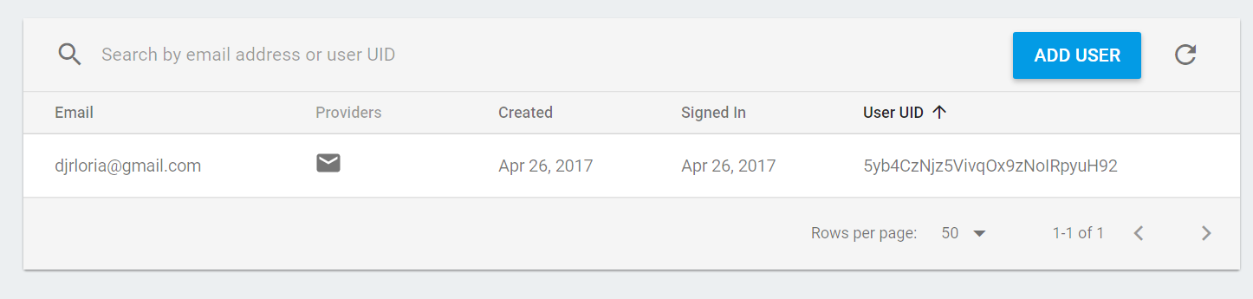
Firebase User Management

Slide 12
Firebase Data Structure

